Slide 1


CHCIW – 2025 Investor Conference Presentation
TWSE：1727
November 28, 2025
Copyright ® Chung Hwa Chemical Industrial Works, Ltd. All rights reserved

Slide 2


Disclaimer
This presentation is prepared based on the Company’s financial statements audited by certified public accountants in accordance with IFRS.
All complete financial information shall be based on the officially disclosed financial statements.
This presentation is compiled from information obtained from various sources. Certain information may be affected by future uncertainties and may differ from the Company’s current outlook. Any future revisions or adjustments shall be subject to announcements on the Market Observation Post System (MOPS).
This presentation shall not be construed as an offer or solicitation to purchase or sell any securities or financial products.。

Slide 3

Presentation Outline
Company Overview
Operating Performance
Corporate Transformation & Strategy
ESG & Energy Management
Q&A

Slide 4
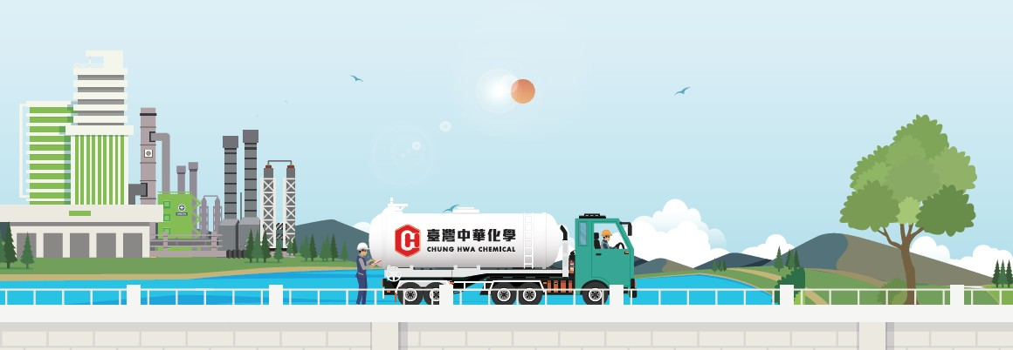
Company Overview

Slide 5
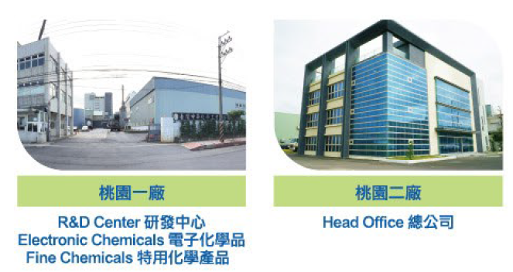
公司簡介
Chairman
  KEN,WEN-YUEN
Major Products / Services
Basic Chemicals：Acids & Alkalis
Water Treatment Chemicals
Specialty Chemicals：Customized Resins
Plastic Monomer Synthesis
Electronic Chemicals：Electronic-grade Sulfuric Acid
Etching Solutions / Photoresist Developing Chemicals
High-purity Fine Chemicals
President
  KAN, KAI-EN
spokesman
  KAN, KAI-EN （CEO）
Acting spokesperson
  CHENG,CHING-AN（CFO）
Establishment time
  1956
Capital
  NT$ 1.253 billion (as of 2025/09/30)
Number of employees
  277人(2025/10/31)
address
  No. 15, Industrial Road 5, Shulinli, Guanyin District, Taoyuan City

Slide 6
Operating Performance

Slide 7
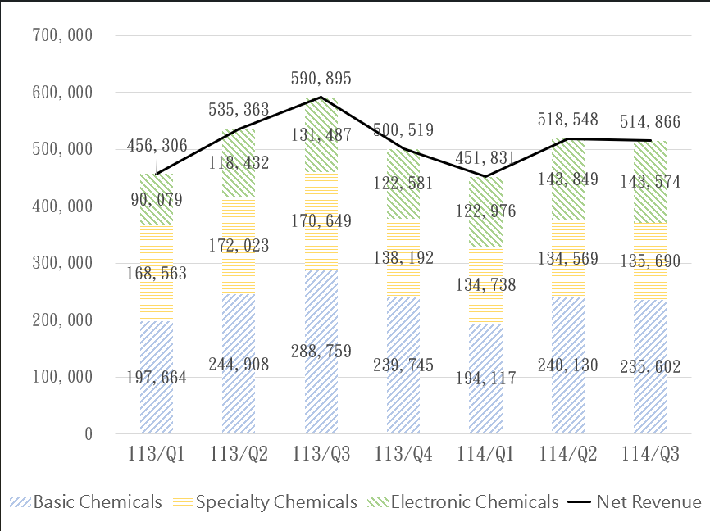
每季收入
Quarterly Revenue
Unit: NTD Thousand

Slide 8
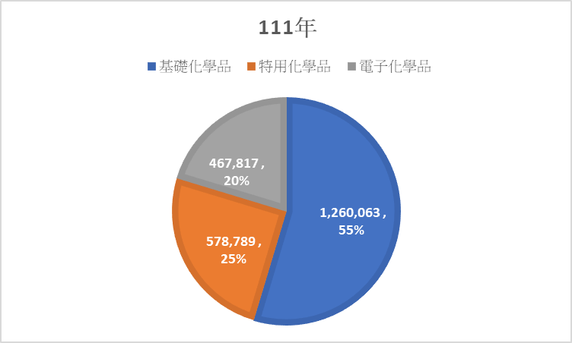
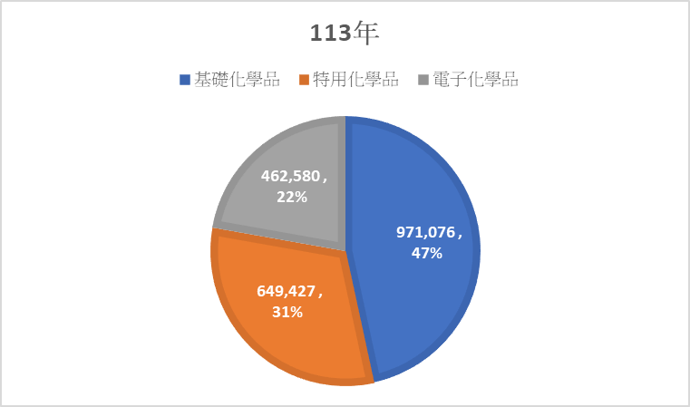
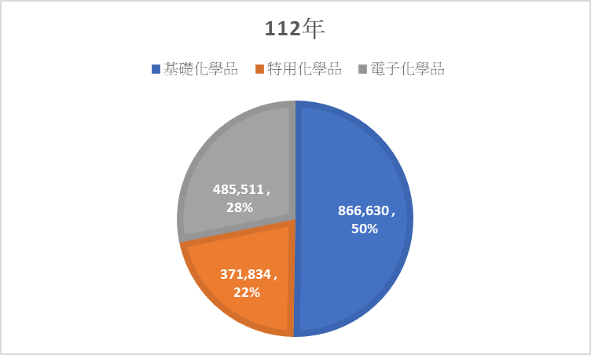
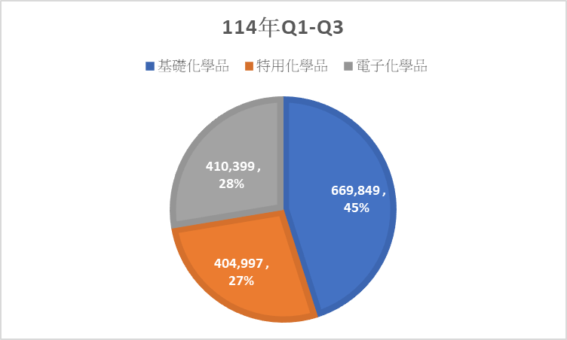
Quarterly Major Product Mix Table

Slide 9
損益表-單季
Income Statement – Single Quarter
 |  |  |  |  |  |  |  |  |  |  | In NT$ millions
Item | 3Q25 |  |  | 2Q25 |  |  | QoQ | 3Q24 |  |  | YoY
Net Revenue | 515 |  | 100.0% | 519 |  | 100.0% | -1.0% | 591 |  | 100.0% | -13.0%
Cost Of Revenue | 462 |  | 89.7% | 455 |  | 87.7% | 2.0% | 501 |  | 84.8% | -8.0%
Gross Profits | 53 |  | 10.3% | 64 |  | 12.3% | -17.0% | 90 |  | 15.2% | -41.0%
Operating Expenses | 51 |  | 10.0% | 56 |  | 10.8% | -8.0% | 56 |  | 9.4% | -8.0%
Net Operating Income | 2 |  | 0.3% | 8 |  | 1.5% | -78.0% | 34 |  | 5.8% | -95.0%
Non-Operating Items | 1 |  | 0.1% | 2 |  | 0.4% | -70.0% | 1 |  | 0.1% | 37.0%
Income Before Income Tax | 2 |  | 0.5% | 10 |  | 2.0% | -77.0% | 35 |  | 5.9% | -93.0%
Income Tax Benefit (Expenses) | (0) |  | -0.1% | (2) |  | -0.4% | -78.0% | (7) |  | -1.3% | -94.0%
Net Profit From Continuing Operations | 2 |  | 0.4% | 8 |  | 1.6% | -76.0% | 28 |  | 4.7% | -93.0%
Discontinuing Operation Income | 0 |  | 0.0% | 0 |  | 0.0% | - | 0 |  | 0.0% | 0.0%
Net Income | 2 |  | 0.4% | 8 |  | 1.6% | -76.0% | 28 |  | 4.7% | -93.0%
Basic EPS (NT Dollar) | 0.02 |  |  | 0.06 |  |  | -67.0% | 0.22 |  |  | -91.0%

Slide 10
Q3 Consolidated Income Statement
 |  |  |  |  |  |  |  |  | In NT$ millions
Item | 1Q~3Q25 |  |  | 1Q~3Q24 |  |  | YoY
Net Revenue | 1,485 |  | 100.0% | 1,583 |  | 100.0% | (97) |  | -6.0%
Cost Of Revenue | 1,327 |  | 89.3% | 1,367 |  | 86.4% | (41) |  | -3.0%
Gross Profits | 159 |  | 10.7% | 215 |  | 13.6% | (57) |  | -26.0%
Operating Expenses | 157 |  | 10.6% | 155 |  | 9.8% | 2 |  | 1.0%
Net Operating Income | 1 |  | 0.1% | 60 |  | 3.8% | (59) |  | -98.0%
Non-Operating Items | 3 |  | 0.2% | 4 |  | 0.3% | (1) |  | -22.0%
Income Before Income Tax | 5 |  | 0.3% | 65 |  | 4.1% | (60) |  | -93.0%
Income Tax Benefit (Expenses) | (1) |  | -0.1% | (10) |  | -0.6% | 9 |  | -90.0%
Net Profit From Continuing Operations | 4 |  | 0.2% | 55 |  | 3.5% | (51) |  | -93.0%
Discontinuing Operation Income | 0 |  | 0.0% | 0 |  | 0.0% | 0 |  | 0.0%
Net Income | 4 |  | 0.2% | 55 |  | 3.5% | (51) |  | -93.0%
Basic EPS (NT Dollar) | 0.03 |  |  | 0.45 |  |  | (0.42) |  | -93.0%

Slide 11
資產負債表
Consolidated Balance Sheet

Slide 12
現金流量表
Statement of Cash Flows
 |  | (All Amounts in Thousands of New Taiwan Dollars)
Item |  | 2025 Q1~Q3 |  | 2024 Q1~Q3
Operating Activities
Profit (Loss) Before Tax |  | 4,582 |  | 64,514
Depreciation & Amortization |  | 178,031 |  | 174,939
Others |  | (232) |  | 744
Changes in Operating Assets / Liabilities |  | (55,177) |  | (60,469)
Interest Received / Paid |  | (8,153) |  | (4,588)
Income Tax Paid |  | (18,866) |  | (227)
Net Cash Inflow from Operating Activities |  | 100,185 |  | 174,913
Investing Activities
Acquisition / Disposal of PPE (Net) |  | (336,784) |  | (189,916)
Increase in Prepayments for Equipment |  | (37,677) |  | (100,681)
Others |  | 10,560 |  | (1,900)
Net Cash Outflow from Investing Activities |  | (363,901) |  | (292,497)
Financing Activities
Increase in Borrowings |  | 330,727 |  | 70,451
Cash Dividends Paid |  | (62,683) |  | (35,539)
Others |  | (5,121) |  | (3,829)
Net Cash Inflow from Financing Activities |  | 262,923 |  | 31,083
Cash Summary |  | (793) |  | (86,501)
Beginning Cash Balance |  | 145,528 |  | 209,123
Ending Cash Balance |  | 144,735 |  | 122,622

Slide 13
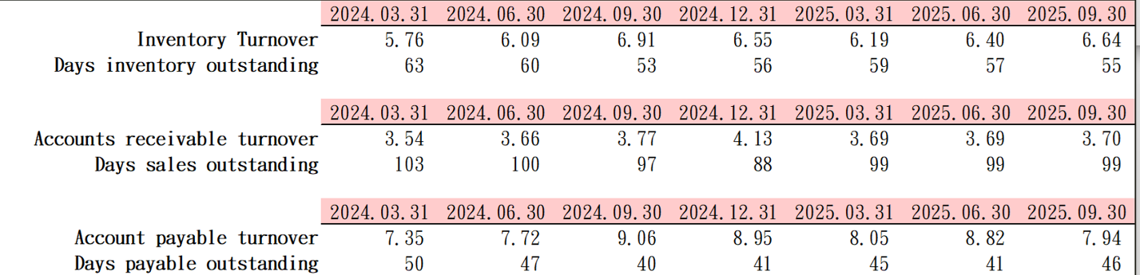
週轉率及週轉天數
Turnover Ratios & Days Outstanding

Slide 14
Corporate Transformation & Strategy

Slide 15

Product Development
Electronic Chemicals Department
Specialty Chemicals Department
Basic Chemicals Department
The existing four electronic-grade sulfuric acid production lines have an operating rate of 70%.
The fifth electronic-grade sulfuric acid production line is expected to be completed in Q1 of next year, with an annual output of 30,000 tons
Extending from serving the water treatment industry to circular economy applications, we provide solutions rather than simply selling products.
  High frequency resin materials
  Aerospace fuel
  Engineering plastic monomers
The expansion of the product line provides more diverse services
Strengthening semiconductor supply capabilities
Focus on the co-development model

Slide 16



Business Deployment
Strengthening presence in semiconductor, high-performance plastics, and circular economy supply chains
Customer-application-driven product development
Direct engagement with semiconductor manufacturers to track market trends
Rapid product specification adjustments aligned with market demand
In 2022, the company closed its Qidong plant in China and focused its resources on Taiwan's semiconductor and chemical supply chain.
Actively invest in semiconductors, high-end resins, and the circular economy to enhance operational concentration and added value.

Slide 17
ESG & Energy Management

Slide 18

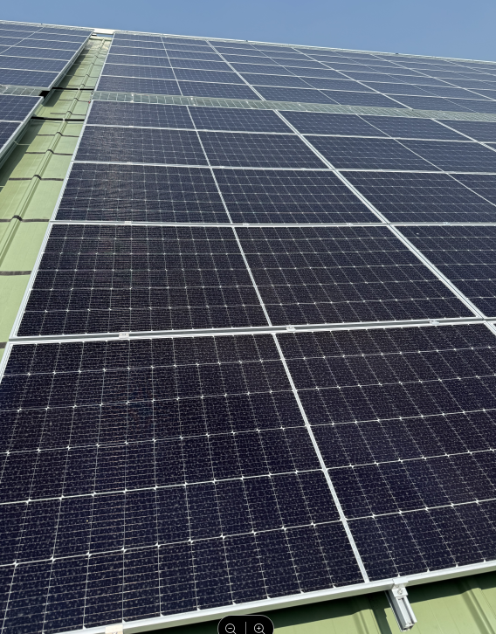

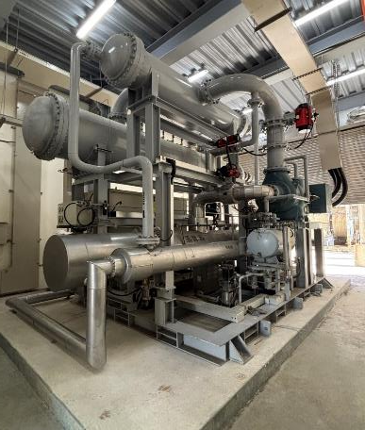
ESG & Energy Management
Solar power generation benefits (September 2025 – November 2025): Activated from September 2025: 99,100 kWh of electricity generated.
Launched product carbon footprint accounting
Carbon audits for 3 production sites to be completed in 2025
Collaborating with customers on carbon-reduction initiatives
ORC Power Generation Benefits (January 2025 – November 2025): ORC system operating days: 114 days; Power generation: 1,034,050 kWh

Slide 19

http://www.chciworld.com.tw chciw@chciw.com.tw
Q&A
14

Slide 20
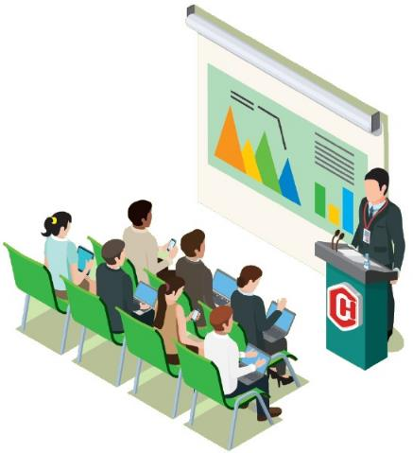
Thank You for Your Attention
We welcome your feedback and questions.

